Slide 1

Analog & Digital Sound
A supplemental lesson for AP CSP

Slide 2
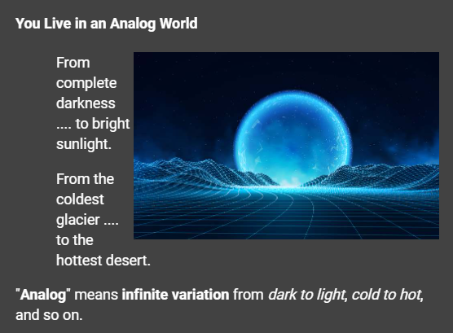
Analog to Digital Conversion

Slide 3
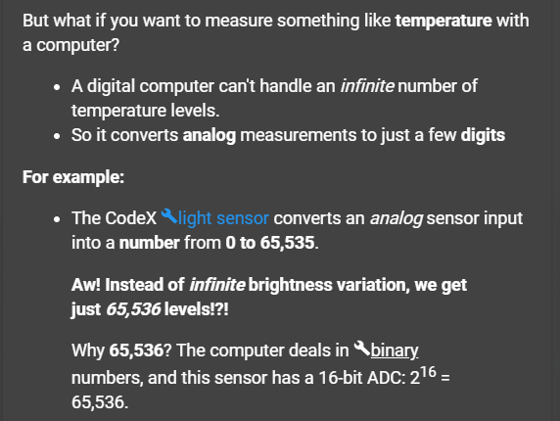
Analog to Digital Conversion

Slide 4
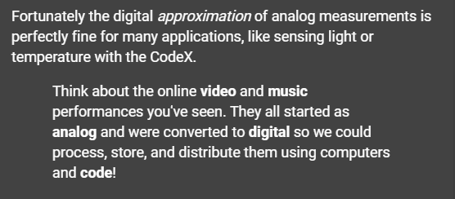
Analog to Digital Conversion

Slide 5
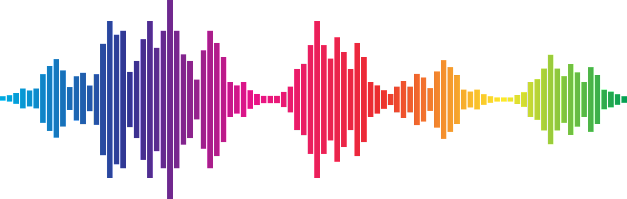
What is Analog?
Smooth and continuous signals that represent a quantity, like sound wave.

Slide 6
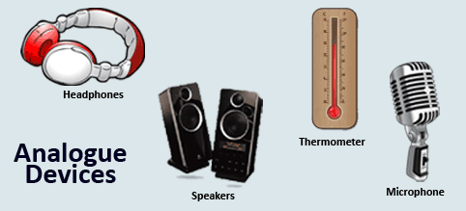
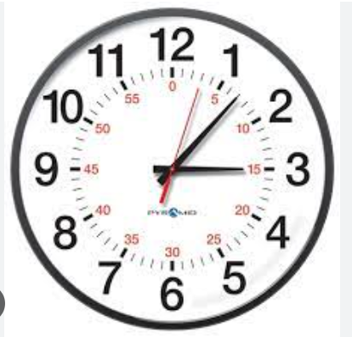
Analog Devices

Slide 7
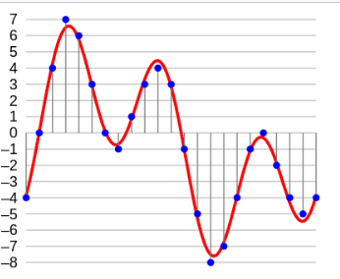
What is Digital?
A numeric representation of an analog signal, represented in increments.

Slide 8
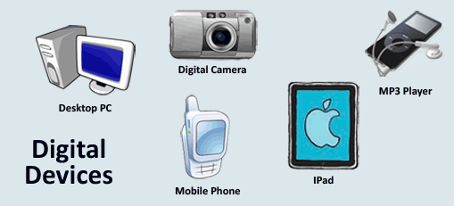
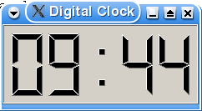
Digital Devices

Slide 9
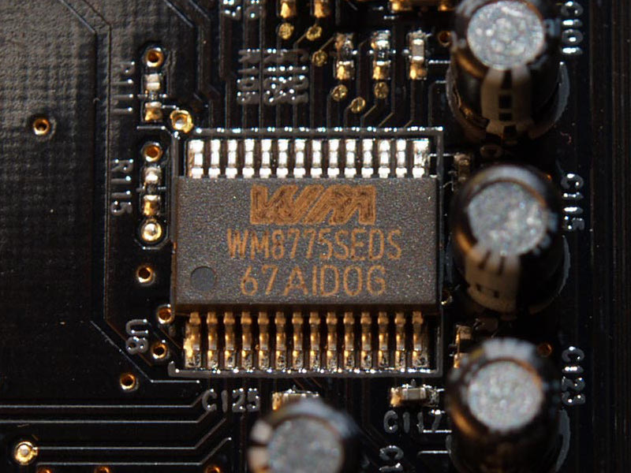
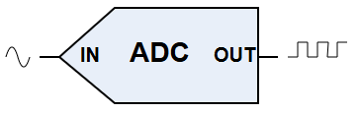
Converting Analog to Digital
Analog signals can be converted to digital signals using an ADC.
Analog-to-Digital Converter (ADC)
a system that converts an analog signal, such as a sound picked up by a microphone or light entering a digital camera, into a digital signal.
The computer represents the digital signal using binary.
ADC Photo credit:
Andrzej Barabasz 🇵🇱 - Own work, CC BY-SA 3.0, https://commons.wikimedia.org/w/index.php?curid=2015779

Slide 10
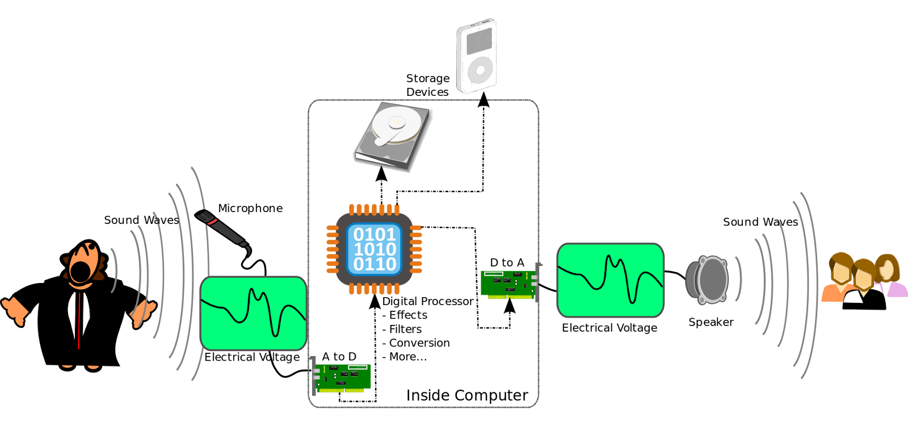
The Lifecycle of Sound
From its source, through an ADC, digital processing, a DAC, and finally as sound again.
Attribution: File:A-D-A Flow.svg, From Wikimedia Commons, the free media repository

